Slide 1
Supervised Learning Reliance on Data

Slide 2
Overfitting

Slide 3
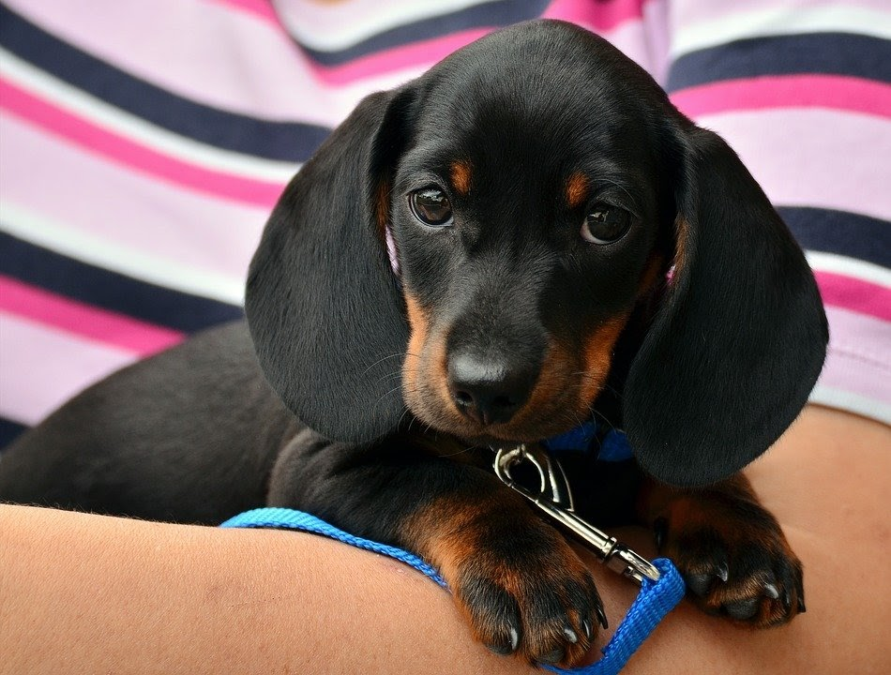
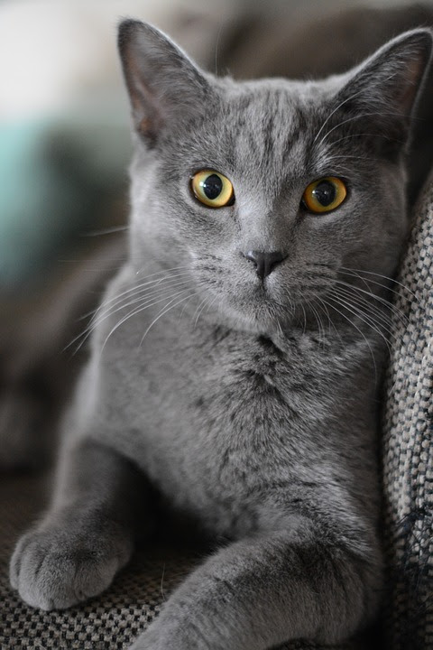


Overfitting
Characteristics
The model performs very well during training
Dog
Cat
99% Accuracy

Slide 4
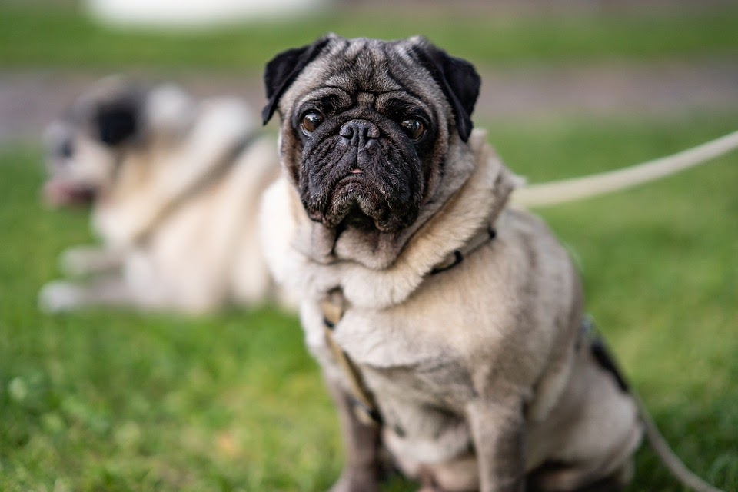
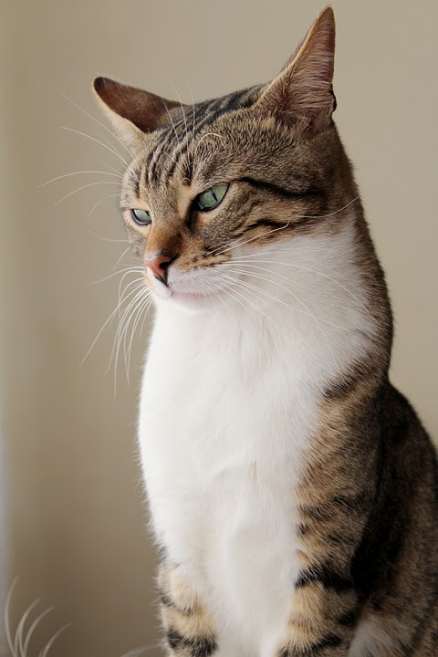

Overfitting
Characteristics
The model performs very well during training
The model performs very poorly on different data
Dog
Cat
99% Accuracy
Cat
Dog
30% Accuracy

Slide 5
Overfitting
Possible Reasons
The model did not learn general enough features
The model focuses on the wrong features

Slide 6
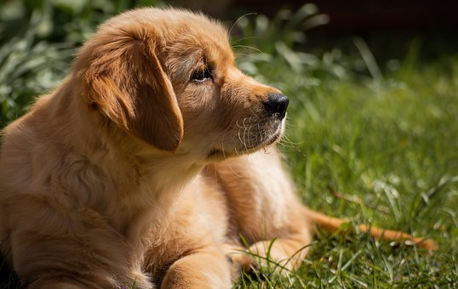
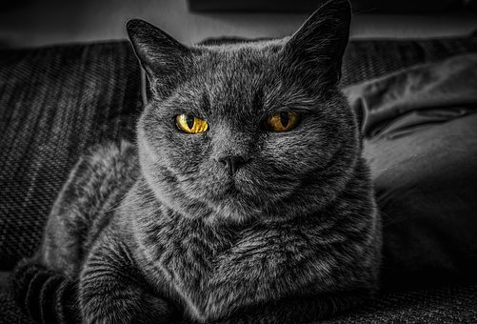
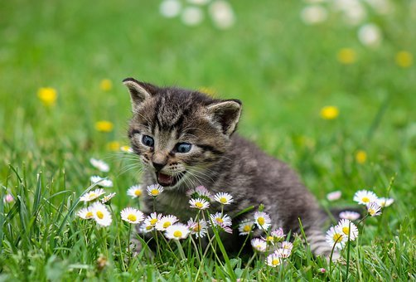
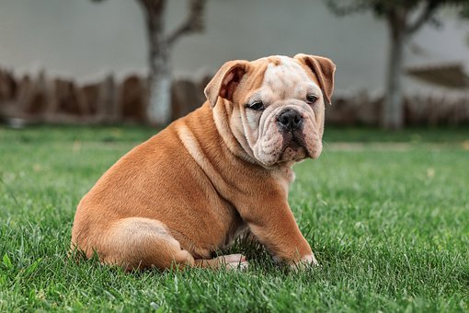
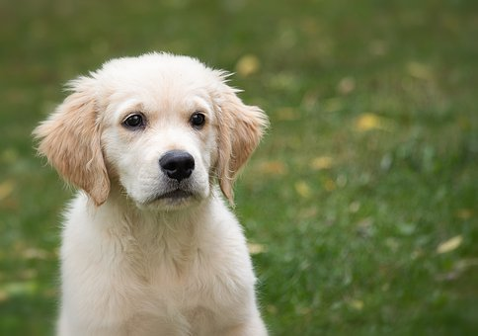
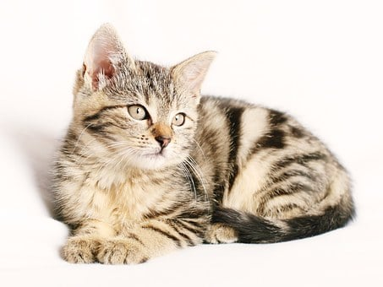
Overfitting
Example 1
Most images of dogs in the training set contain grass, therefore every image with grass will be classified as a dog.
dog
cat
dog
dog
dog
cat

Slide 7
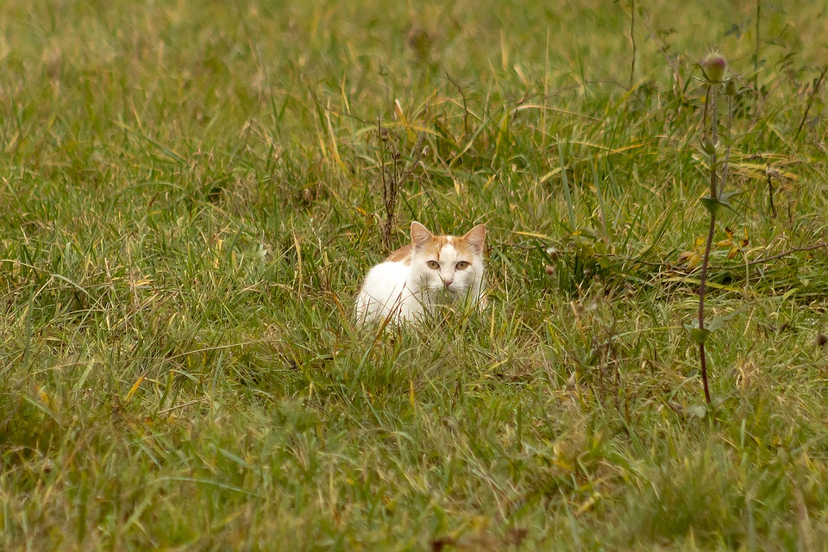
Overfitting
Example 2
All images are closeups of cats, therefore a image of a cat in a field will not be reconized.
cat
cat
not a cat
cat
cat

Slide 8
Overfitting
What examples can you think of?

Slide 9
Overfitting
What examples can you think of?
Focus on hand holding object
Focus on person or object in the background
Focus on body posture instead of facial expression
Focus on hair and jewelry instead of face
Focus on hand position instead of gestures
All training images where shot in daylight
…

Slide 10
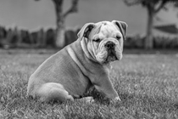
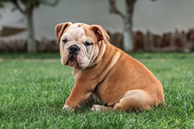
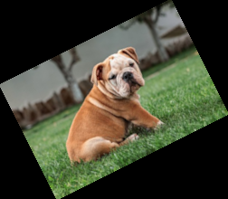
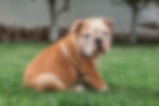
Overfitting
Possible solutions
More data
Better generalized data
Processing data to reduce insignificant differences
Increase variety by:
…
scaling
blurring
desaturating
flipping
rotating

Slide 11
Underfitting

Slide 12
Underfitting
Characteristics
the model just does not provide usable results
Cat
Cat
50% Accuracy

Slide 13
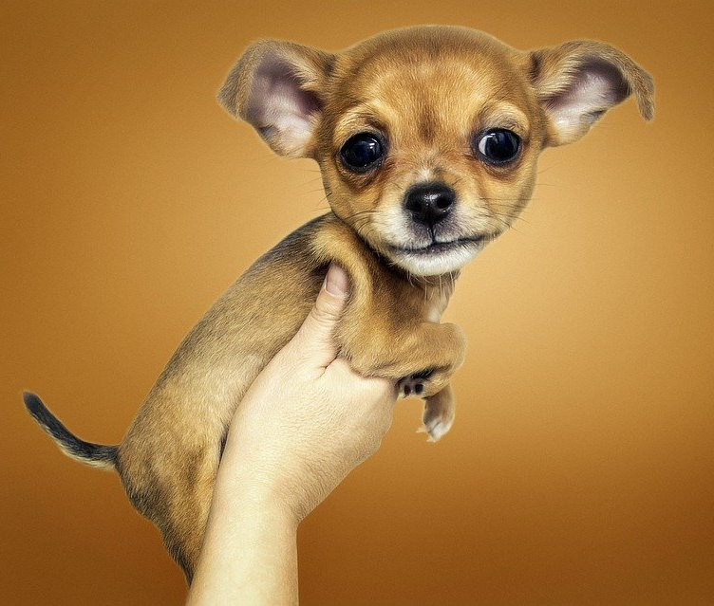

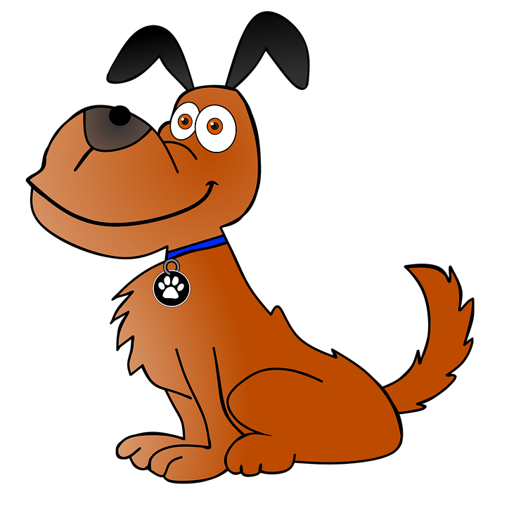
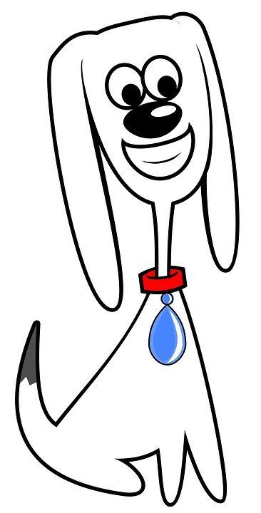
Underfitting
Possible Reasons
Too few samples
Training data is too general
(Training parameters are way off)
cat
CAT
cat
dog
cat
dog
dog

Slide 14
Underfitting
Possible Solutions
Use more/better samples for trainings-data
Adjust training parameters (more iterations, …)

Slide 15
Biases and Fairness

Slide 16
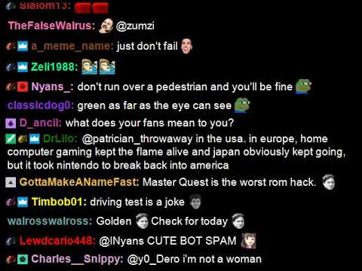
Biases and Fairness
Imagine you create a chatbot that should act like a normal human. Therefore you use live-chats from streaming platforms like Twitch or YouTube for training.
GPLv3 - https://github.com/cairthenn/TwitchChatVideo

Slide 17
Biases and Fairness
Imagine you create a chatbot that should act like a normal human. Therefore you use live-chats from streaming platforms like Twitch or YouTube for training.
How well do you think this bot would perform?
Do you see any problems that could occur?
GPLv3 - https://github.com/cairthenn/TwitchChatVideo

Slide 18
Biases and Fairness
Network replicates what it has seen/learned
racism, sexism, vulgarity, ...
bias towards streamers with a loud audience
bias towards names and norms that are relevant at the time of training
…

Slide 19
Biases and Fairness
Network replicates what it has seen/learned
racism, sexism, vulgarity, ...
bias towards streamers with a loud audience
bias towards names and norms that are relevant at the time of training
…
Hard to create unbiased algorithms
Ethical question on where to use such algorithms
Where should machines be allowed to make decisions?
How can we guarantee an fair and unbiased result?

Slide 20
Training Time and Transfer Learning

Slide 21
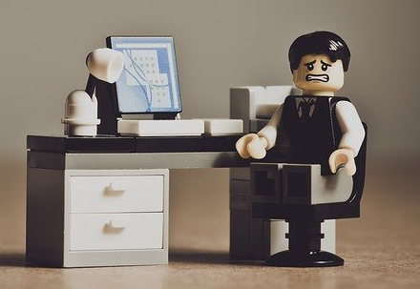
Training Time
Training a good model from scratch can take weeks
If you include finding the right parameters it can even take months or years…

Slide 22
Transfer Learning
Uses an already trained model as a starting point
Requires much less trainings-data
usable results often with a few dozens of images
Requires much less time
usually seconds to minutes
Many pre-trained models are freely available
especially for image recognition

Slide 23
Up next
Training a real world image classification model and use it to control a game of Snake!

